Slide 1
Lecture 8 : NFA -∊ to NFA and Closure Under Regular Operations
Agenda
How to convert NFA -∊ to NFA
Closure Under Regular Operations
The class of regular languages is closed under the Union operation
The class of regular languages is closed under the Concatenation operation
The class of regular languages is closed under the Star operation
Presented by
Prof. Vaibhav Narayan Chunekar
K. J. Somaiya College off Engineering, Vidyavihar, Mumbai

Slide 2
Importance of NFA- ∊
It is difficult to draw an NFA or DFA directly from the language description.
NFA -∊ accept same language as NFA
NFA-∊ helps to split up the complex problem into smaller one

Slide 3
Equivalence of NFA -∊ to NFA
NFA N = (Σ, Q, q₀, F, δ’) ➔ δ’=Q X Σ➔2^{Q}
NFA N- ∊ = (Σ, Q, q₀, F, δ) ➔ δ=Q X Σ U {∊ } ➔2^{Q}
Transition➔δ’(q,a)= ∊ closure (δ( δ(q, ∊),a))
➔ δ(q, ∊)= ∊ closure (q)

Slide 4
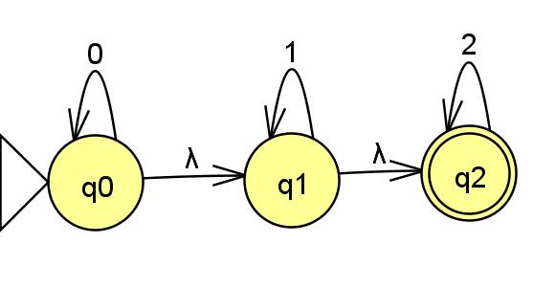
Example : NFA -∊ Transition

Slide 5
Using ∊ closure at initial state
∊ closure(q0)= {q0,q1,q2}
∊ closure(q1)={q1,q2}
∊ closure(q2)={q2}
F➔{q2}
F’➔{q0,q1,q2}

Slide 6
Using ∊ closure for other States
δ’(q₀,0)= ∊ closure (δ( δ(q₀, ∊),0))
δ’(q₀,0)= ∊ closure (δ( δ{q₀,q1,q2},0))
δ’(q₀,0)= ∊ closure (δ(q₀,0)U δ(q₁,0) U δ(q₂,0))
δ’(q₀,0)= ∊ closure ( {q0} U {} U {}) ➔{ }=Empty Set=∅
δ’(q₀,0)= ∊ closure (q0)
δ’(q₀,0)= {q₀,q1,q2}
--------------------------------------------------------------------
δ’(q₀,1)= ∊ closure (δ( δ(q₀, ∊),1))
δ’(q₀,1)= ∊ closure (δ( δ{q₀,q1,q2},1))
δ’(q₀,1)= ∊ closure (δ(q₀,1)U δ(q₁,1) U δ(q₂,1))
δ’(q₀,1)= ∊ closure ( {} U {q1} U {}) ➔{ }=Empty Set=∅
δ’(q₀,1)= ∊ closure (q1)
δ’(q₀,1)= {q1,q2}

Slide 7
Using ∊ closure for other States
δ’(q₀,2)= ∊ closure (δ( δ(q₀, ∊),2))
= ∊ closure (δ( δ{q₀,q1,q2},2))
= ∊ closure (δ(q₀,2)U δ(q₁,2) U δ(q₂,0))
= ∊ closure ( {} U {} U {q2}) ➔{ }=Empty Set=∅
= ∊ closure (q2)
δ’(q₀,2)= {q2}
--------------------------------------------------------------------
δ’(q₁,0)= ∊ closure (δ( δ(q₁, ∊),0))
= ∊ closure (δ( δ{q1,q2},0))
= ∊ closure ( δ(q₁,0) U δ(q₂,0))
= ∊ closure ( {} U {} ) ➔{ }=Empty Set=∅
= ∊ closure ({})
δ’(q₀,1)= {}

Slide 8
Using ∊ closure for other States
δ’(q₁,1)= ∊ closure (δ( δ(q₁, ∊),1))
= ∊ closure (δ( δ{q1,q2},1))
= ∊ closure ( δ(q₁,1) U δ(q₂,1))
= ∊ closure ( {q1} U {} ) ➔{ }=Empty Set=∅
= ∊ closure ({q1})
δ’(q₁,1)= {q1,q2}
-------------------------------------------------------------------
δ’(q₁,2)= ∊ closure (δ( δ(q₁, ∊),2))
= ∊ closure (δ( δ{q1,q2},2))
= ∊ closure ( δ(q₁,2) U δ(q₂,2))
= ∊ closure ( {q2} U {} ) ➔{ }=Empty Set=∅
= ∊ closure ({q2})
δ’(q₁,2)= {q2}

Slide 9
Using ∊ closure for other States
δ’(q2,0)= ∊ closure (δ (q2,0))
= ∊ closure ( {}) ➔{ }=Empty Set=∅
= δ’(q₂,0)= {}
-------------------------------------------------------------------
δ’(q2,1)= ∊ closure (δ (q2,1))
= ∊ closure ( {}) ➔{ }=Empty Set=∅
= δ’(q₂,1)= {}
--------------------------------------------------------------------
δ’(q2,2)= ∊ closure (δ (q2,2))
= ∊ closure ( {q2}) ➔{ }=Empty Set=∅
= δ’(q₂,1)= {q2}

Slide 10
State Transition Table without ∊ moves
 | 0 | 1 | 2
q0 | {q0,q1,q2} | {q1,q2} | {q2}
q1 | {} or ∅ | {q1,q2} | {q2}
q2 | {} or ∅ | {} or ∅ | {q2}
Σ Q

Slide 11
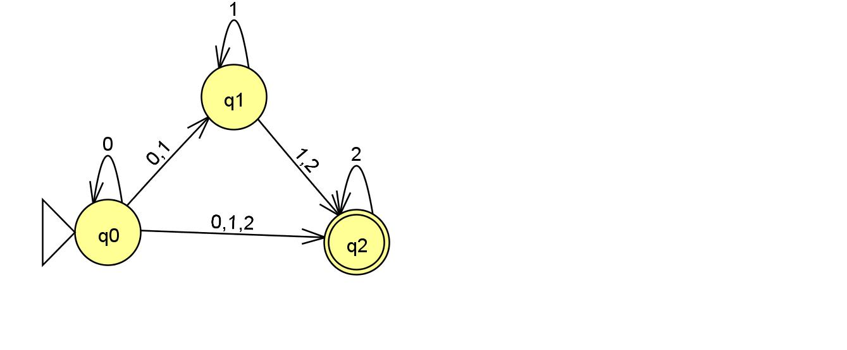
Resultant NFA

Slide 12
Unreachable State and Dead State (Trap State)
Unreachable State: A state is said be unreachable state if it not able reach from initial state. These state don’t take part in construction of DFA and hence must be removed in order to construct minimise DFA.
Dead State (Trap State)/(Dump State): This state is non final state whose transition of every input symbol terminate on them. Such state don’t possess any outgoing transition except to themselves. We usually removed Dead State in order to construct minimised DFA

Slide 13
Closure Under Regular Operations
If L1 and L2 are regular language then
L1 U L2
L1.L2
L*
are also regular.

Slide 14
Construction of NFA with regular operations
Union Operation:
For a regular language , we can assume that there is NFA accepting it with unique accepting state.
L1= regular Language N1=NFA Accept State=r1
L2= regular Language N2=NFA Accept State=r2 then
L1=L(N1) and L2=L(N2) then we construct new NFA as such-
NFA=(L1 UL2)
This can elaborate with figure below.

Slide 15
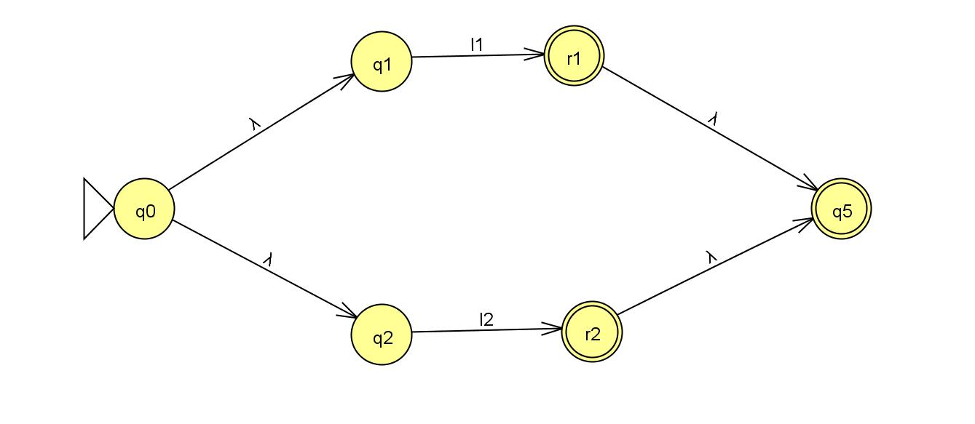
Union Operation: L1 U L2

Slide 16
Construction of NFA with regular operations
Concatenation Operation:
For a regular language , we can assume that there is NFA accepting it with unique accepting state.
L1= regular Language N1=NFA Accept State=r1
L2= regular Language N2=NFA Accept State=r2 then
L1=L(N1) and L2=L(N2) then we construct new NFA as such-
NFA=(L1 .L2)
This can elaborate with figure below.

Slide 17
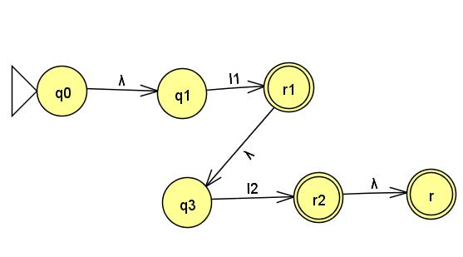
Concatenation Operation: L1 . L2

Slide 18
Construction of NFA with regular operations
Star Operation:
For a regular language , we can assume that there is NFA accepting it with unique accepting state.
L1= regular Language N1=NFA Accept State=r1
L1=L(N1) then we construct new NFA as such-
NFA=(L1 )*
This can elaborate with figure below.

Slide 19
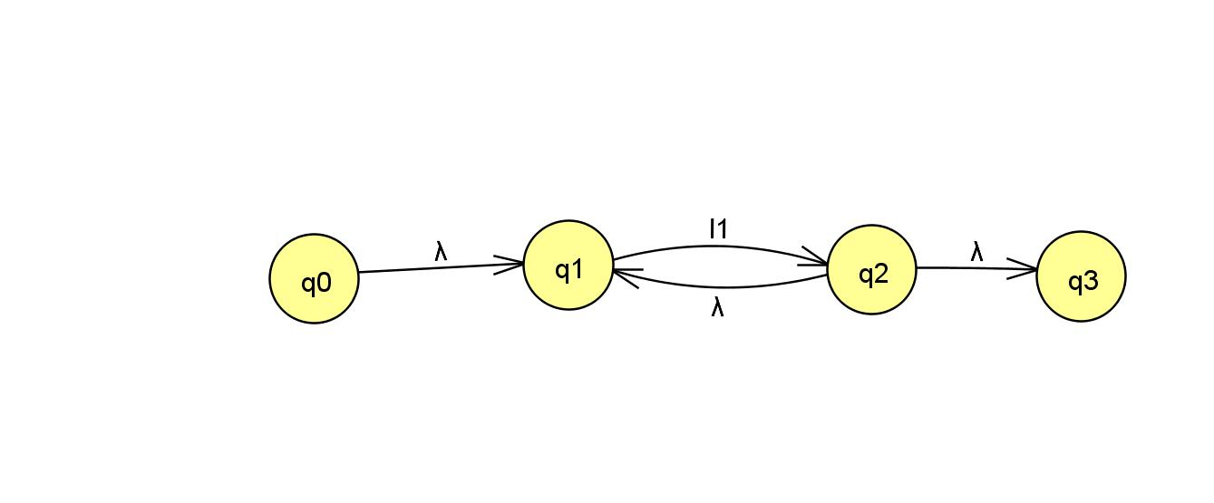
Star Operation: L1*

Slide 20
Thanking you. Any Query???

